Slide 1





DATA ANALYTICS AND BUSINESS INTELLIGENCE
ARTIFICIAL INTELLIGENCE
AND
MACHINE LEARNING
EVENT ATTENDANCE DASHBOARD
18AMC401JT
Guided by,
Ms. SIVASANKARI
IBM Corporate Trainer
Presented by,
JAYANTHAN S [927622BAL016 ]
BATCH : 2022 - 2026
ACADEMIC YEAR : 2025 - 2026
FINAL YEAR - AIML

Slide 2

ABSTRACT
The Event Attendance Dashboard stands as a strategic command center that unifies every thread of an organisation’s event ecosystem, capturing attendance patterns, participant behavior, and logistical efficiency in one consolidated, insight-driven flow. It blends the timeless discipline of structured registers with the agility of modern data intelligence, enabling teams to monitor real-time turnout, analyse engagement trends, forecast capacity needs, and benchmark event performance with boardroom-ready clarity. By integrating registration data, check-in activity, feedback sentiment, and resource utilization, the dashboard transforms scattered details into a cohesive narrative that empowers leaders to make grounded, future-aligned decisions.

Slide 3
INTRODUCTION
The Event Attendance Dashboard brings clarity and structure to how organisations plan, track, and evaluate their events. By centralising event details, attendance records, registrations, and feedback into one system, it provides a streamlined view of employee engagement across the organisation. Through real-time analytics and intuitive visualisations, the dashboard improves planning accuracy, optimises resource usage, and strengthens overall event performance. Blending traditional record-keeping discipline with modern data intelligence, it helps leaders understand participation patterns, anticipate future needs, and make confident, informed decisions. Ultimately, the dashboard enhances transparency, supports stronger engagement, and promotes a culture of continuous improvement throughout the organisation.

Slide 4
PROBLEM STATEMENT
Organisations often depend on manual or scattered methods to track event attendance, registrations, and feedback, leading to inconsistent data and limited visibility. Without real-time insights or a unified system, it becomes difficult to analyse participation trends, plan resources effectively, or evaluate event performance. This creates delays, inaccuracies, and weak decision-making. Therefore, a centralized, data-driven Event Attendance Dashboard is needed to streamline information, provide real-time analytics, and support efficient, informed event management.

Slide 5
OBJECTIVE
The primary objective of the Event Attendance Dashboard is to centralise all event-related information such as attendance records, registrations, feedback, and logistics into a single, unified system. By providing real-time insights and visual analytics, the dashboard aims to help organisations understand participation trends, evaluate event performance, and improve planning accuracy. It further seeks to optimise resource allocation, enhance overall engagement, and support faster, data-driven decision-making. Through this streamlined approach, the system enables teams to manage events more efficiently and deliver meaningful improvements across the organisational event process.

Slide 6
DATASET OVERVIEW
The dataset combines all key event-related information, including event details, attendee records, registrations, attendance logs, feedback ratings, and logistics data. These structured data points provide a complete view of participation patterns, event performance, and operational insights, forming the foundation for accurate analysis and meaningful dashboard visualisations.

Slide 7
KEY INSIGHTS
Insight | Visualization Type | Purpose
Attendance Trend | Line Chart | To show changes in attendance over time.
Attendance Status (Present/Absent) | Donut Chart / Bar Chart | To compare participant status across events.
Registration vs Attendance | Column Chart | To measure turnout efficiency and participation gaps.
Event Ratings | Bar Chart / Line Chart | To analyse event satisfaction and performance.
Capacity Utilisation | Bar Chart | To assess how effectively event capacity was used.
Feedback Distribution | Pie Chart / Bar Chart | To understand overall participant experience.
Logistics Cost Analysis | Line Chart / Column Chart | To track cost variations across events.
Department Participation | Bar Chart | To compare engagement across departments.
Event-wise Performance | Clustered Bar Chart | To identify high-performing and low-performing events.
Multi-factor Comparison | Scatter / Bubble Chart | To analyse relationships between capacity, cost, and feedback.

Slide 8
ABOUT YOUR DATA SOURCES & PREPROCESSING
The data for the Event Attendance Dashboard is gathered from multiple organisational systems to ensure a complete and accurate view of event performance. Key sources include event metadata records containing event names, dates, venues, and capacity details; registration datasets capturing participant sign-ups and confirmation status; attendance logs that track check-in and check-out times; and feedback submissions that record attendee ratings and comments. Additional inputs such as logistics information vendor details, setup costs, and resource usage further enrich the dataset. Together, these sources provide a comprehensive foundation for analysing participation patterns, event effectiveness, and operational efficiency.

Slide 9
CONT.,
DATA CLEANING & PREPROCESSING:
The data cleaning and preprocessing phase ensures that all event-related information is accurate, consistent, and ready for analysis. This process begins with removing duplicate entries, correcting inconsistencies, and filling or eliminating missing values to maintain dataset reliability. Date and time fields are standardized to a uniform format, and categorical values such as attendance status, event types, and departments are normalized for consistency. During preprocessing, key features such as check-in time patterns, event capacity usage, and feedback indicators are extracted to enhance analytical depth. Data from multiple CSV files or database sources is integrated into a single structured dataset, and aggregated as needed across events, dates, and departments. Normalization techniques are applied to ensure smooth scaling and accurate visual comparisons across all dashboard charts and metrics.

Slide 10
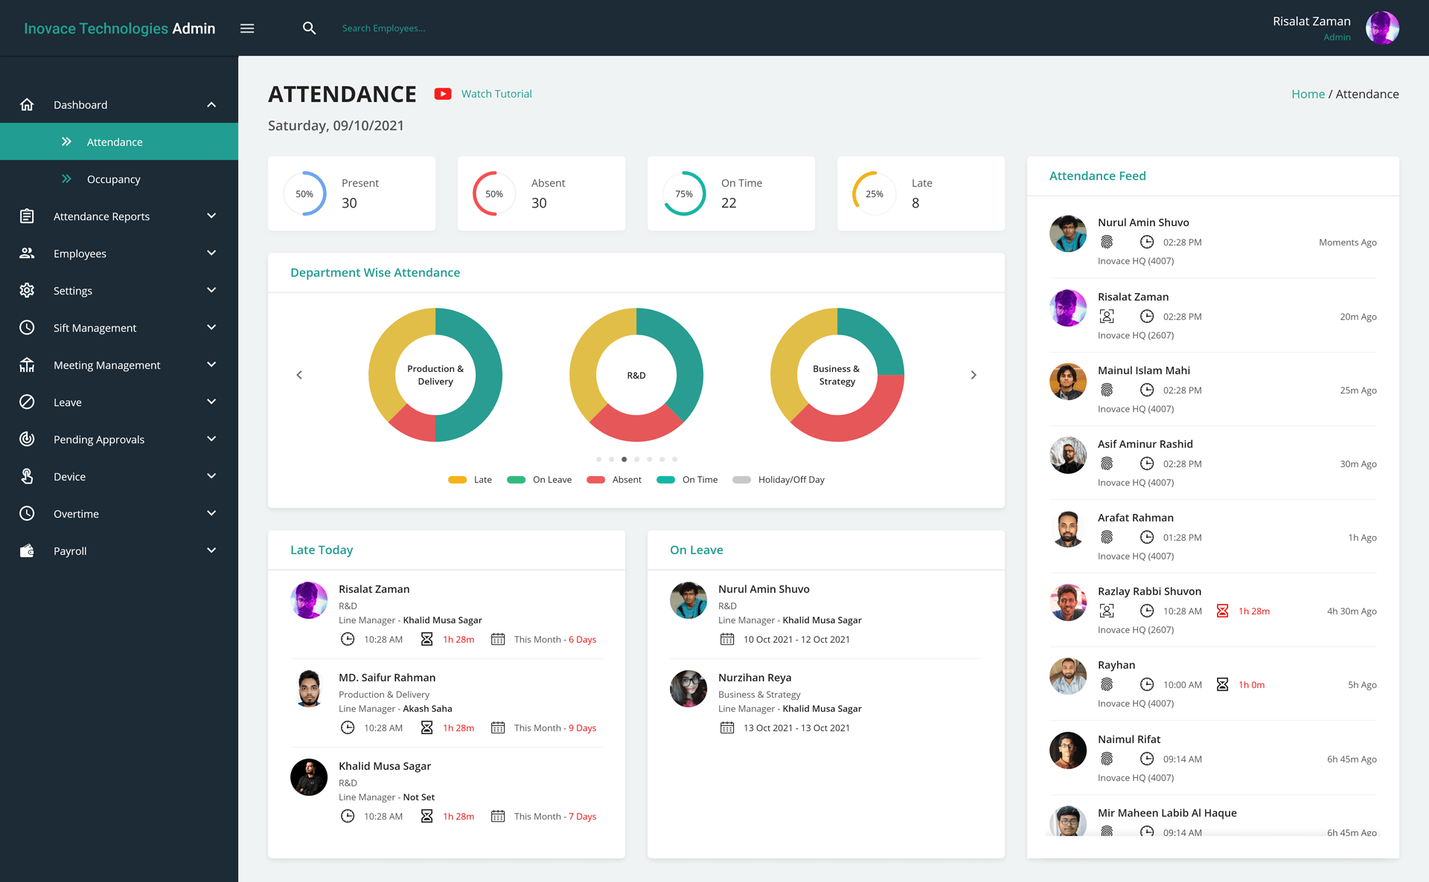
EXISTING SYSTEM

Slide 11
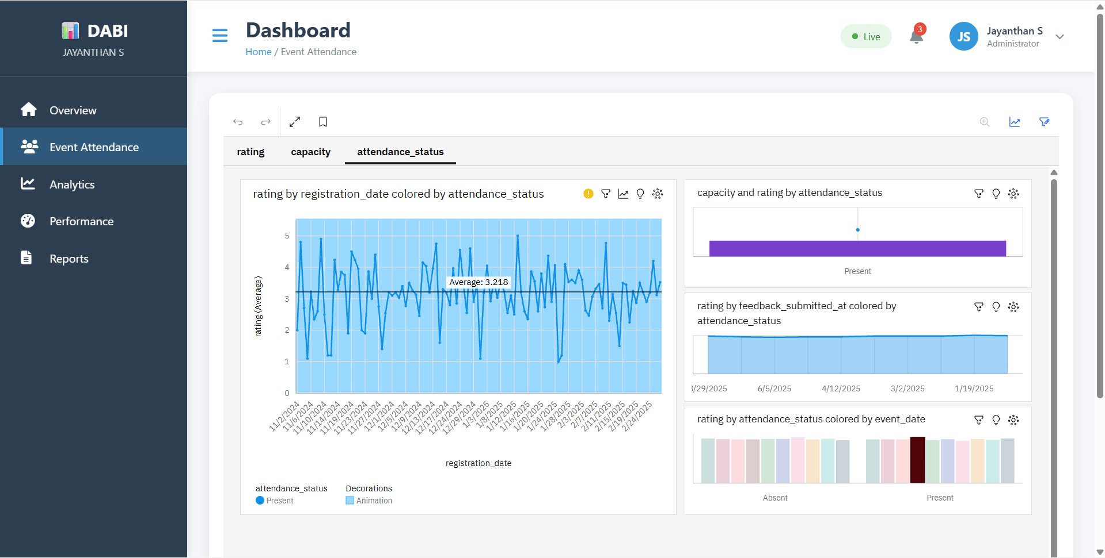
DASHBOARD IMPLEMENTATION

Slide 12
TOOLS AND TECHNOLOGY
Category | Technology / Tool
Frontend | HTML, CSS, JavaScript, React.js
Backend | Node.js, Express.js
Database | MongoDB
Data Visualization | Power BI / IBM Cognos / Tableau
Hosting Platform | IBM Cloud or Local Server
Development Tools | Visual Studio Code, GitHub
Languages Used | JavaScript, SQL

Slide 13
ADVANTAGES :
Centralizes all event-related data in one system.
Provides real-time attendance and engagement insights.
Improves planning accuracy and resource allocation.
Offers clear visualizations for easy analysis.
Reduces manual errors and speeds up decision-making.
DISADVANTAGES
• Requires accurate data input to ensure reliability.
• Needs basic BI tool knowledge for effective use.
• Initial data preparation can be time-consuming.
• Dependent on tool limitations for large datasets.
• Real-time tracking may still need additional technologies.

Slide 14
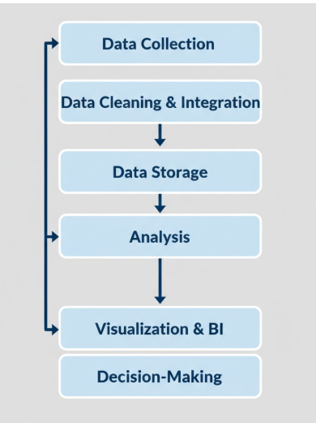
WORKFLOW CHART

Slide 15
CONCLUSION
  The Event Attendance Dashboard provides a streamlined, data-driven solution for tracking and analysing event performance within an organisation. By centralising attendance records, registrations, feedback, and logistics information, the system improves visibility, accuracy, and decision-making. Its visual insights help teams understand participation trends, optimise event planning, and enhance overall engagement. Ultimately, the dashboard supports efficient event management and contributes to a more organised, transparent, and informed decision-making process.

Slide 16
FUTURE ENHANCEMENTS
Future improvements to the Event Attendance Dashboard may include integrating real-time check-in technologies such as QR codes, RFID, or biometric systems for more accurate attendance tracking. AI-based analytics can be added to predict engagement trends and recommend optimal event timings or content. Automated sentiment analysis on feedback comments can offer deeper insights into participant experience. Cloud-based storage can enhance scalability, while mobile app integration can provide on-the-go event insights. These enhancements would make the system more intelligent, efficient, and user-friendly.

Slide 17
GITHUB LINK
https://github.com/jayathansenthilkumar/Veo

Slide 18

THANK YOU

